Slide 1
Bike riding
Do I go different distances on resistance 6 compared to resistance 5?

Slide 2
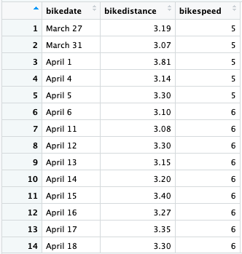
For 14 days I collected data on how far I went
riding my indoor bike.
The relevant variables here are the bike resistance setting
and the distance I went.
(For April 1 part of the time I was on resistance 1
because I forgot to raise it, but it doesn’t affect
the results)

Slide 3
My assumption is that I would go farther when there is a bit less resistance.
The independent variable here is the resistance and the dependent variable is the distance.

Slide 4
H0: mean distance on resistance 5 = mean distance on resistance 6
Ha: mean distance on resistance 5 > mean distance on resistance 6
Since we’re comparing two different groups, use a two-sample independent T-test

Slide 5
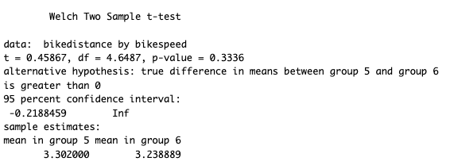
Test statistic = 0.46
P-value = 0.334

Slide 6
Conclusion
Since the p-value is not less than 0.05, fail to reject H0, meaning there is not evidence that I go farther on resistance 5 compared to resistance 6

